Slide 1
Leishmaniasis
Ram Balak Mahto
Guest faculty
Zoology department
v.s.j college Rajnagar Madhubani
Class B.Sc 1st yr. Paper 1, group-A 7908055676

Slide 2
Leishmaniasis
Leishmania donovani (complex) (VL)
Leishmania tropica (CL)
Leishmania major (CL)
Leishmania aethiopica (CL)
Leishmania mexicana (Complex) (CL)
Leishmania brazilliensis (complex) (MCL)
Leishmania peruriana

Slide 3
The Parasite
Phylum
Order
Family
Genus
Sarcomastigophora
Kinetoplastida
Trypanosomatidae
Leishmania

Slide 4
Morphology
Digenetic Life Cycle
Promasitogte
Insect
Motile
Midgut
Amastigote
Mammalian stage
Non-motile
Intracellular

Slide 5
Morphology
Promastigote
Amastigote
Flagella
Kinetoplast
Golgi
Nucleus
Cytoskeleton

Slide 6
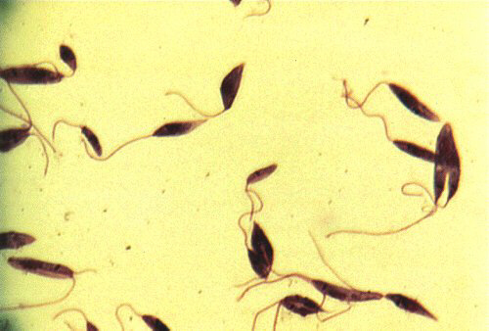
Promastigote

Slide 7
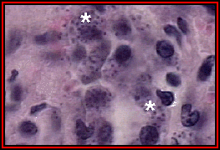
Amastigotes (*) of Leishmania donovani in the cells of a spleen. The individual amastigotes measure approximately 1 µm in diameter.

Slide 8
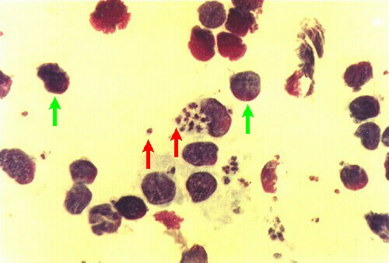
Amastigote

Slide 9
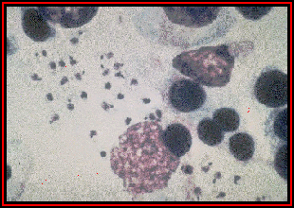
Amastigotes of Leishmania in a macrophage from a lymph node of a dog.

Slide 10
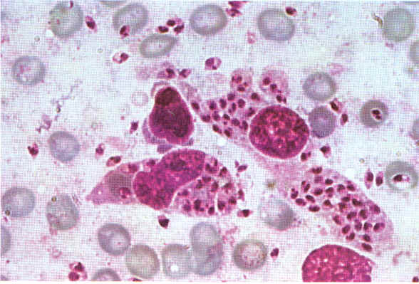
Leishmania (Leishman-Donovan or LD bodies). Lying in macrophage cells from liver.
Giemsa. ×12000. Enlarged by 9.6.

Slide 11
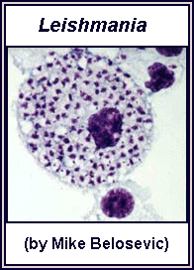
A macrophage filled with Leishmania amastigotes.

Slide 12
Life cycle
The organism is transmitted by the bite of several species of blood-feeding sand flies (Phlebotomus) which carries the promastigote in the anterior gut and pharynx.
It gains access to mononuclear phagocytes where it transform into amastogotes and divides until the infected cell ruptures.
The released organisms infect other cells.
The sandfly acquires the organisms during the blood meal, the amastigotes transform into flagellate promastigotes and multiply in the gut until the anterior gut and pharynx are packed.
Dogs and rodents are common reservoirs.

Slide 13
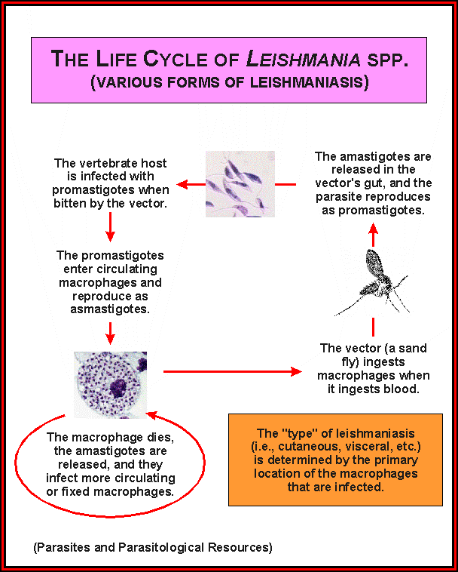

Slide 14
Mammalian Hosts
Sloths
Primates
Dogs
Foxes
Anteaters
. . . . .
Rodents
Gerbils
Hyraxes
Bats
Porcupines
Opossums

Slide 15
Vectors
Phlebotomine Sandflies
6 genera world wide distribution
Phlebotomus & Lutzomia
500 species
Females Haematophagus
Males sap feeders

Slide 16
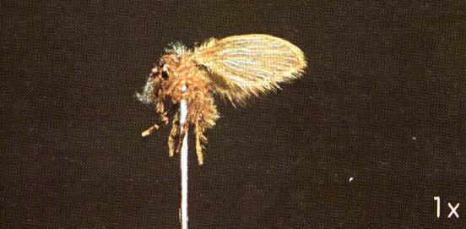

Slide 17
Clinical Disease
Visceral
Fatal (90% untreated)
Liver
Spleen
Bone marrow
Cutaneous
Generally Self- healing
Skin
Mucous membranes
SPECTRUM OF DISEASE

Slide 18
Initial Infection
Similar in all species
Inoculation of promastigotes
Inflammation & chemotaxis
Receptor mediated phagocytosis
Promastigote Amasitgote
Transformation

Slide 19
Parasite Spread
Macrophage lysis & parasite release
Lymphatic spread
Blood spread
Target organs
Skin/lymph nodes/spleen/liver/
bone marrow

